Slide 1
Variables and their type.

Slide 2
Just like we have seen previously, we can think of “variables” as like a basket where we can store information and access it at our will.

Slide 3
Types of Variables
Int
float
01
03
String
boolean*
02
04
Short for integer, can be negative or positive.Only whole numbers.
Floating numbers meaning numbers with decimals.
“String” of characters. In other words it can store anything from 1 character to an entire sentence.
Special type of data usually True of False or 0 or 1. (Yes or No)

Slide 4
ASCII
01

Slide 5
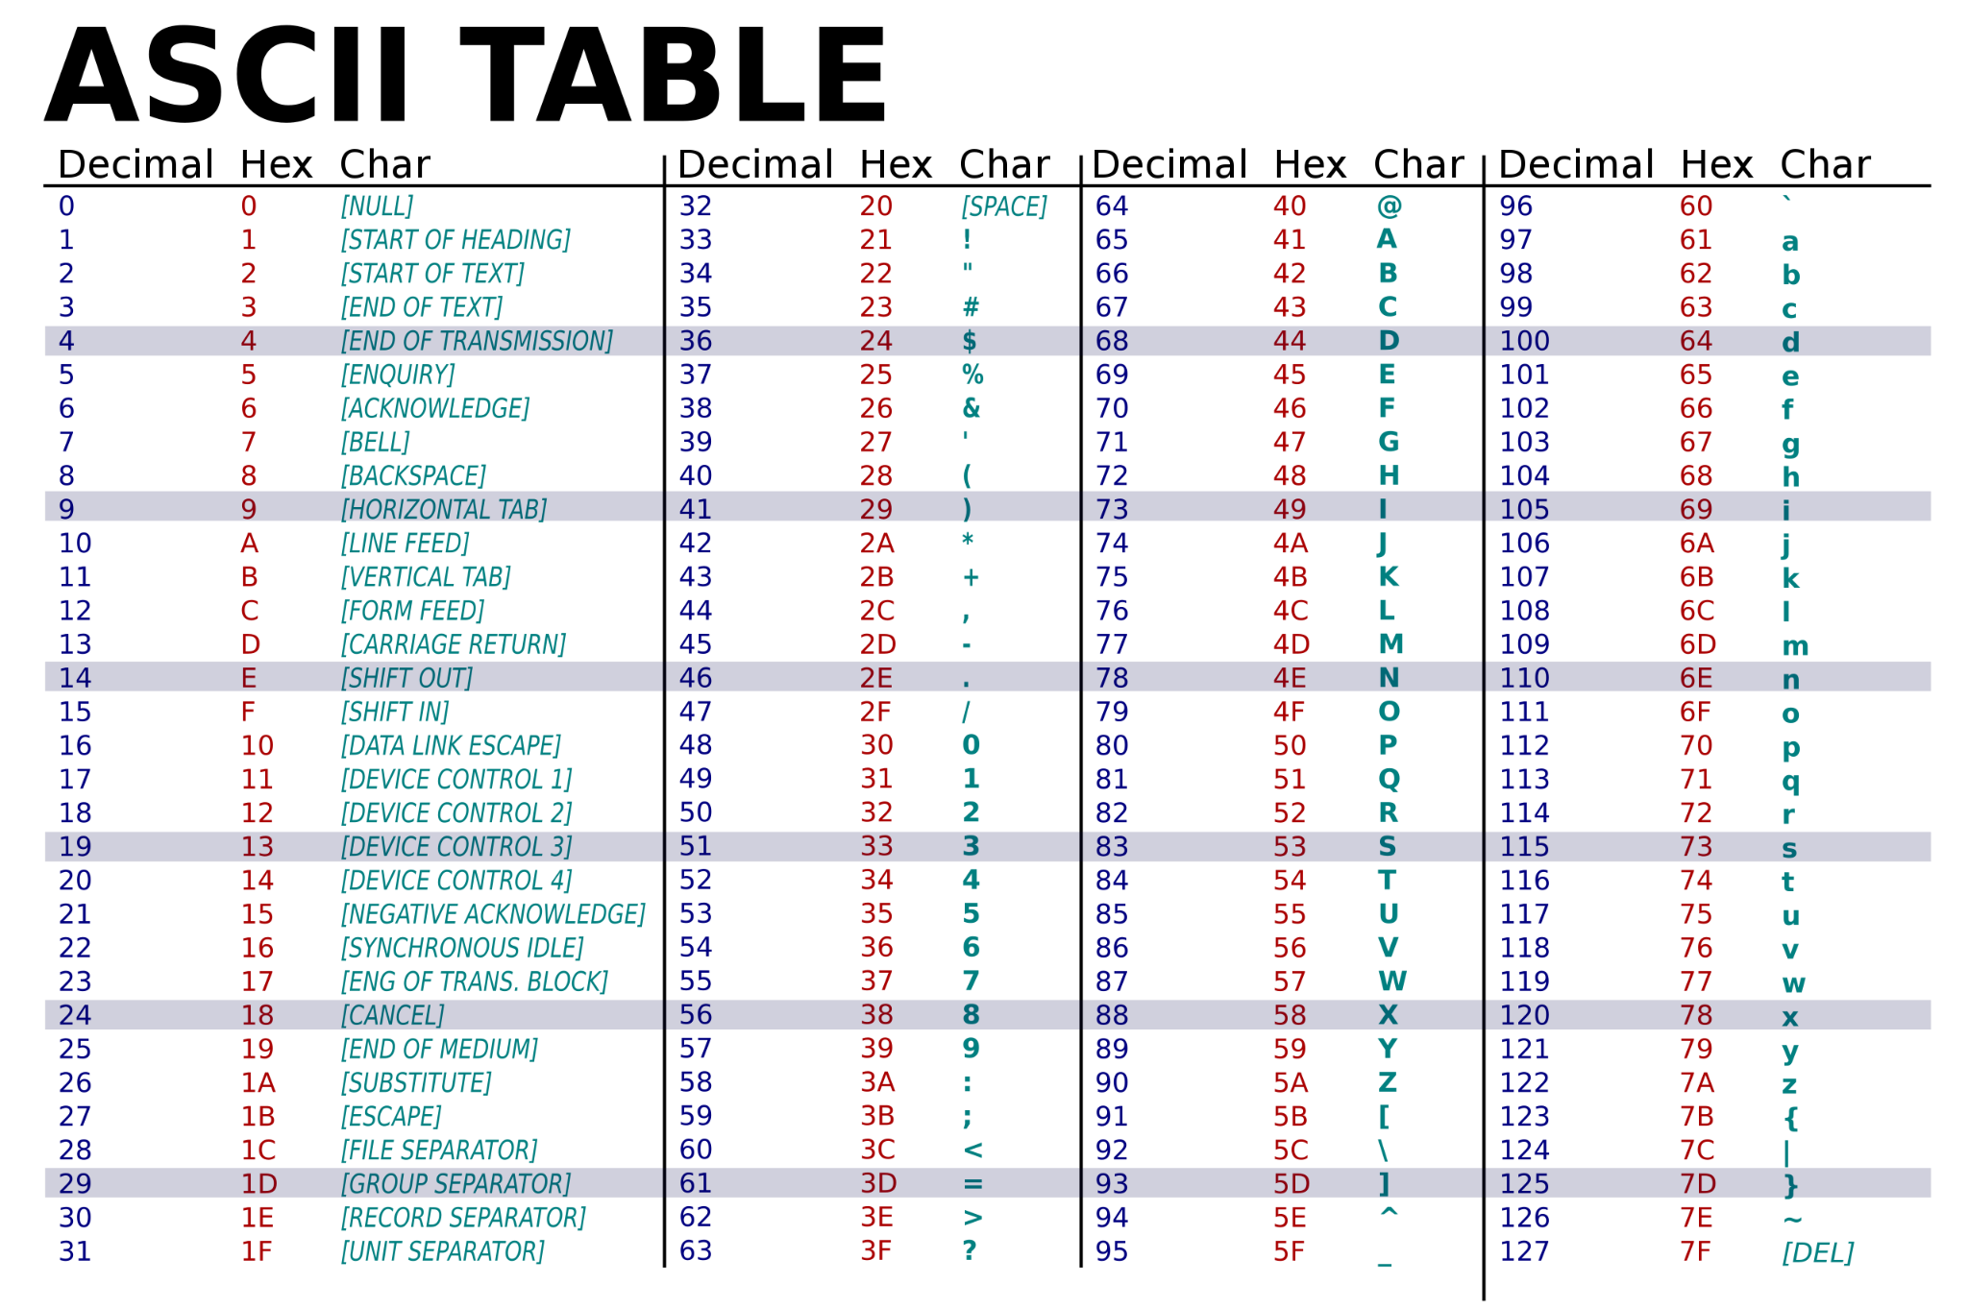

Slide 6
How to read ASCII Table
Decimal
hexa
Character
Our usual number system 0 to 9 in each number digits
Hexa meaning 16 each digit of numbers range from 0 to f(16)
Any of the decimal and hexadecimal corresponds to each character values.
Example: a = 97 = 0x61 (indicate hexadecimal with 0x in front)

Slide 7
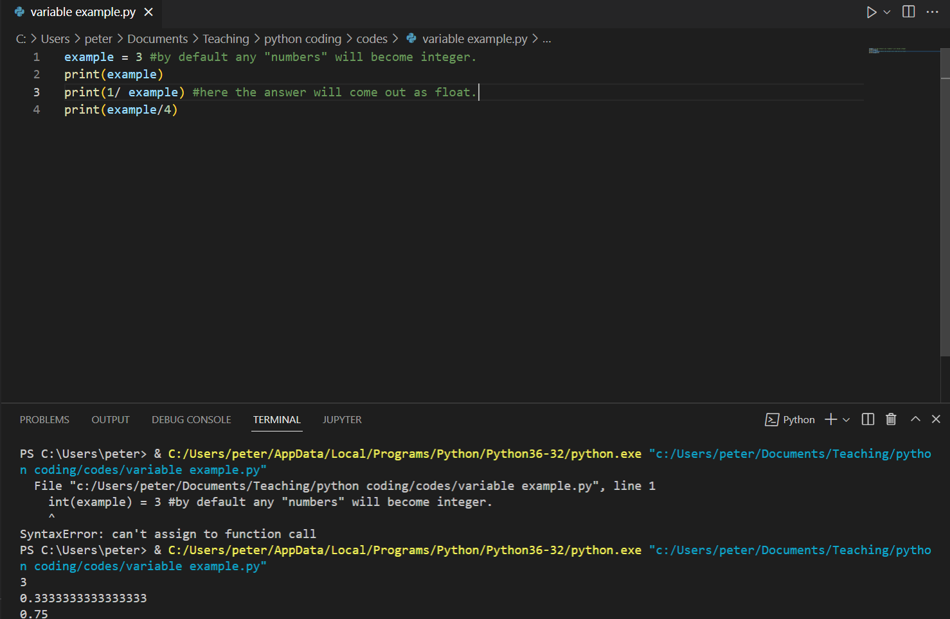
Python made our lives easier
When we input a number..
It will categorize the variable as an integer for us and if we divide it will turn it into float.

Slide 8
You try!

Slide 9
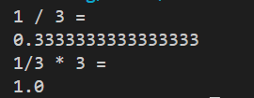
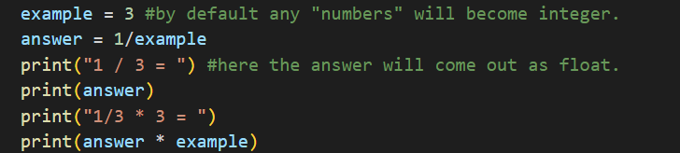
Try inputting any numbers and try divide the numbers with “/” operator. Then try reversing that division by multiplying with “*” operator.

Slide 10
Converting between ASCII
ord( )
chr( )
01
02
“Ord” function will take in an input of character and convert/return them into corresponding integer value.
“Chr” function will take in any integer and give return us the corresponding character from ASCII table.

Slide 11
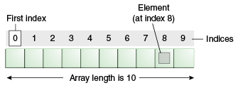
To access a certain character in a string
If string(variable name “example”) has “Hello World!” it has total of 12 characters (includes space)
To access “H” we write example[0]. To access “!” we write example[11].
This is known as array and array indexing. We will get into this later.

Slide 12
Assignment 2

Slide 13
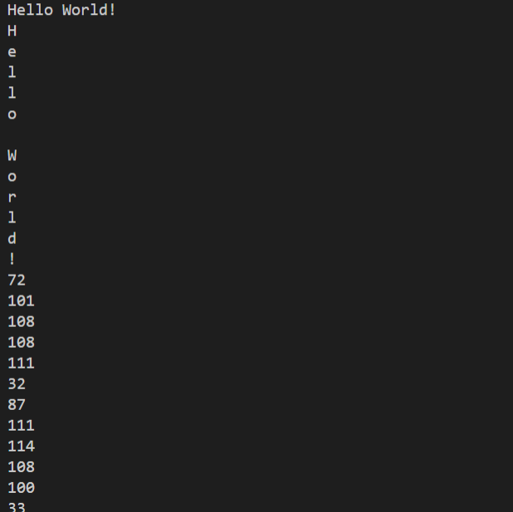
First write a simple message then have the program to print out the letters individually.
Then convert each of those letters to print out the ASCII values in integers individually.
Example below
Try to use spaces.(Yes they are a “character”) special symbols like”.?{})(*&^%$#!@
And no you can not use “hello world!” anymore.
Lowercase and uppercase have different value as well.
To take a step beyond look at what you can do to convert lowercase to uppercase and vice versa.

Slide 14
Arithmetic operators
Adding/subtracting/ multiplying/dividing
Modulus
Exponent
Floor division
“+”, “-”,“*”,”/” simple math I think everyone knows this.
“%” denoted as percent. This will give us the remainder of the division
“**” denoted as double astrix a**x this will raise a to the power of x (a^x)
“//” double slash this will give us the whole number part of the division only.

Slide 15
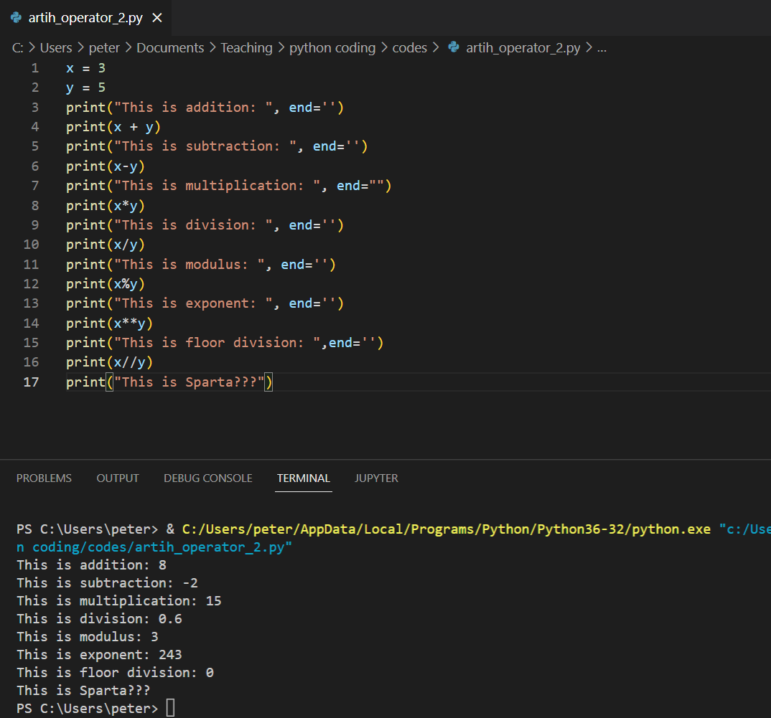
Examples!

Slide 16
Assignment 3

Slide 17
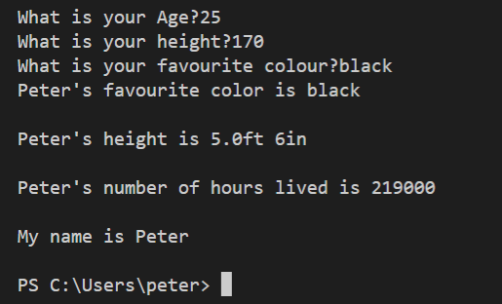
We’ll start from the previous assignment from week 1.(name,age,height,color)
Now the user will input their height in cm and we will convert that into ft/in
Then we will take the age and return it as # of hours living.
Common mistakes: when trying to output the variable make sure they are string not a number. Make sure when doing mathematical operators make sure they are numbers not characters or string.

